Slide 1
EECS 498 System Design of a Search Engine
Winter 2026
Lab 11: Google Cloud Platform Continued
GSI: Christopher Davis
IA: Rickey Dong
Nicole Hamilton
https://web.eecs.umich.edu/~nham/nham@umich.edu

Slide 2
Agenda
Introduction
Project SSH Keys
Creating a VM Instance
Building & Running LinuxTinyServer
Configuring a systemd service

Slide 3
Agenda
Introduction
Project SSH Keys
Creating a VM Instance
Building & Running LinuxTinyServer
Configuring a systemd service

Slide 4
Introduction
Presentations / demos are coming up!
See EdStem post #142
https://edstem.org/us/courses/89542/discussion/7913989

Slide 5
Review
Recall that we went through creating a demo VM in the last lab.
We will now do it again, but more concisely.
To save time, make sure you do it in the same project as last time!

Slide 6
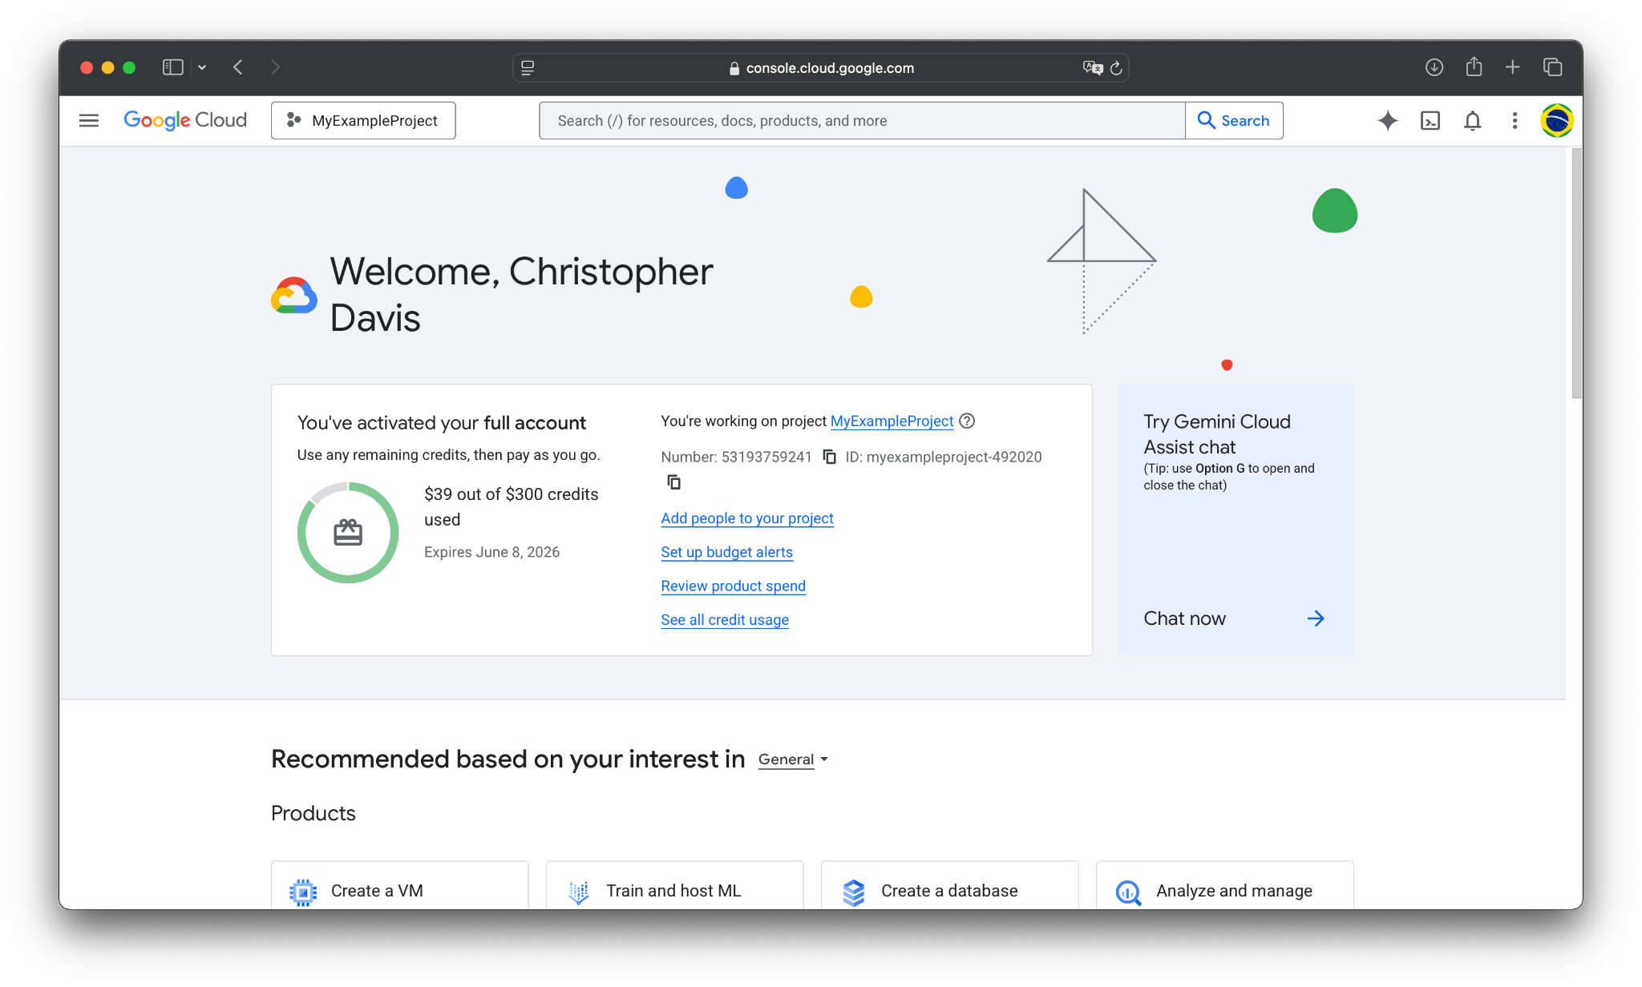


This is your current project;
make sure it’s the right one.

Slide 7
Agenda
Introduction
Project SSH Keys
Creating a VM Instance
Building & Running LinuxTinyServer
Configuring a systemd service

Slide 8
Adding Project SSH Keys
Instead of manually adding SSH keys to each VM, let’s first add them globally to the project.
This allows us to SSH into any Linux VM instance in the project.
In the previous lab, we generated an SSH key at ~/.ssh/gcp_key
Again, copy the output of:
cat ~/.ssh/gcp_key.pub

Slide 9
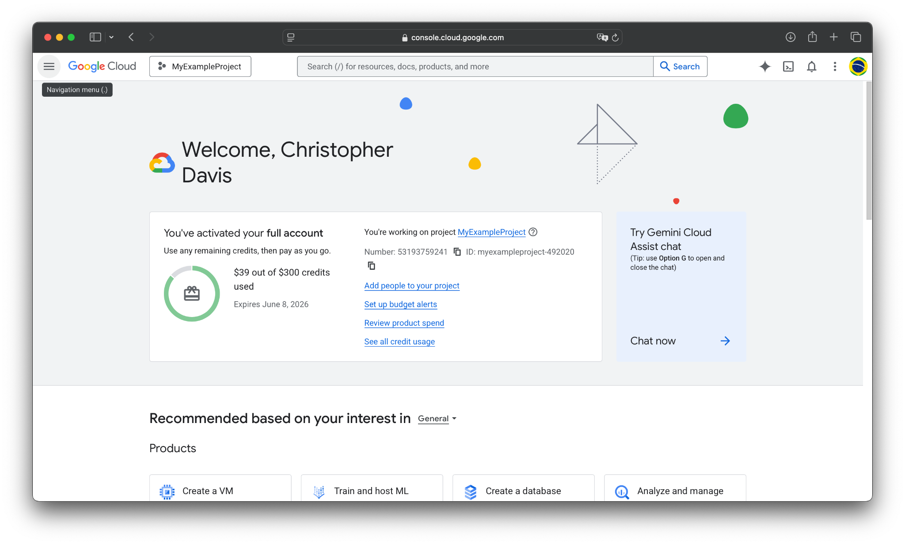
Open the sidebar here.

Slide 10
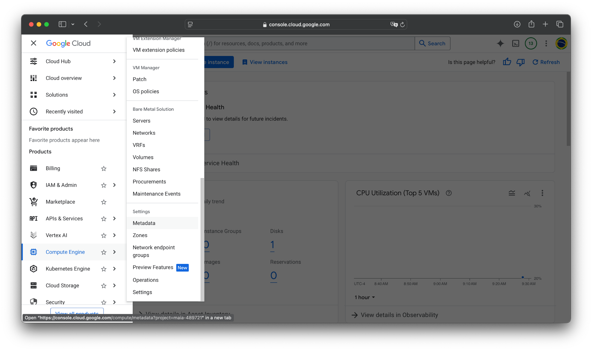
Hover over Compute Engine, then scroll down and click on Metadata.

Slide 11
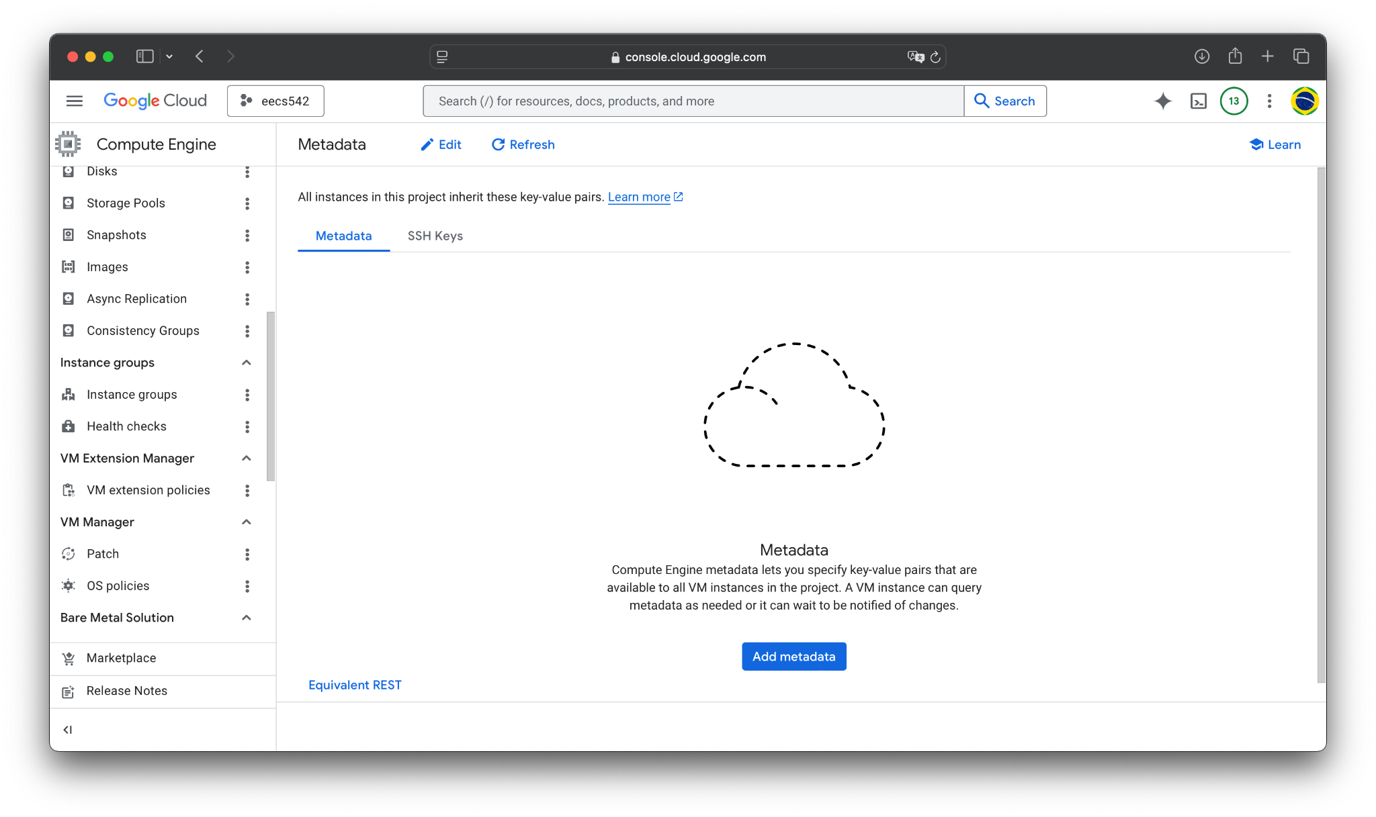
Go to SSH Keys.

Slide 12
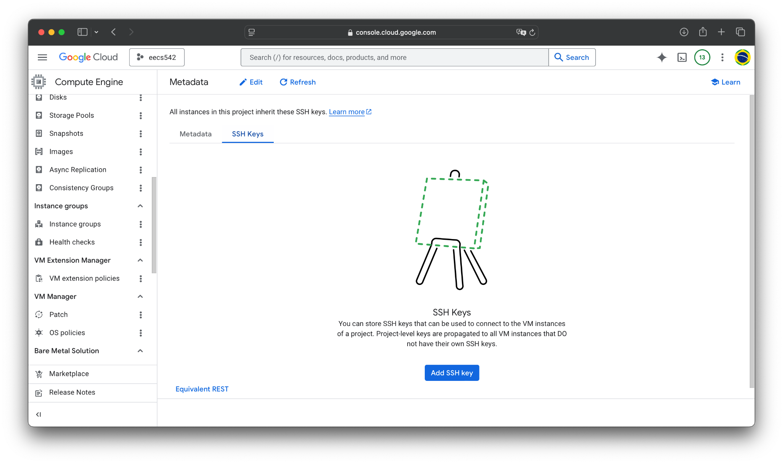
Click Add SSH key.

Slide 13
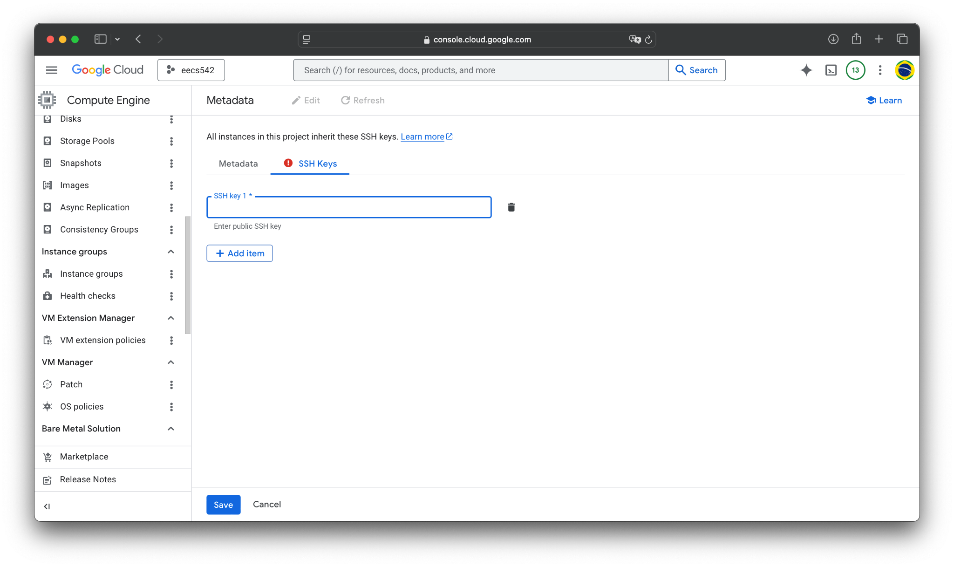
Hit Add item and paste the SSH key here.

Slide 14
Hit Add item and paste the SSH key here.
Then press Save.

Slide 15
Agenda
Introduction
Project SSH Keys
Creating a VM Instance
Building & Running LinuxTinyServer
Configuring a systemd service

Slide 16
Creating a VM Instance
We will create an instance for our web-server with these specs:
Type: e2-medium
OS: Ubuntu 24.04 LTS (Minimal)
Boot Disk: 20GB of Standard Persist Disk
Recall: last lab covered how to do this using the GCP web console.

Slide 17
Open the sidebar here.

Slide 18
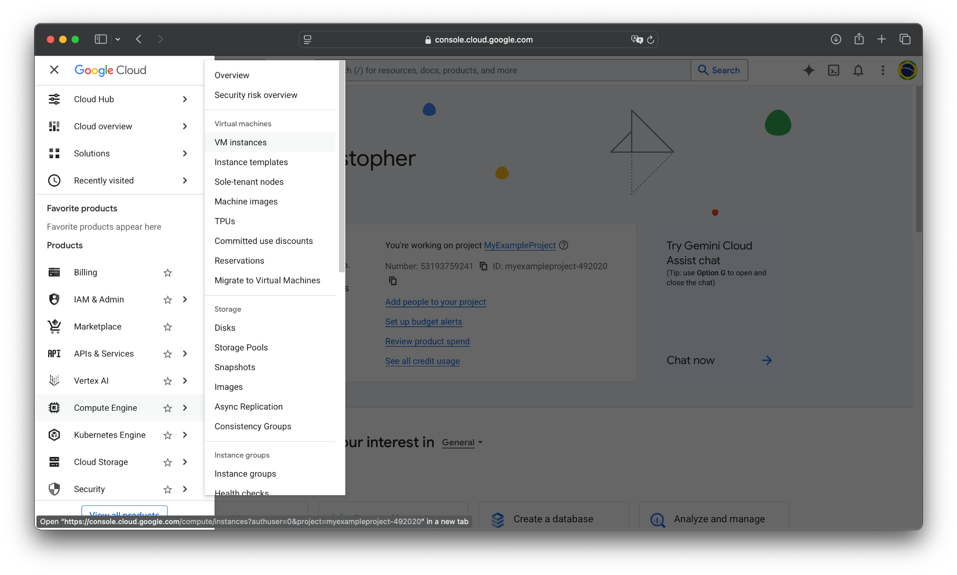
Hover over Compute Engine, then click on VM instances.

Slide 19
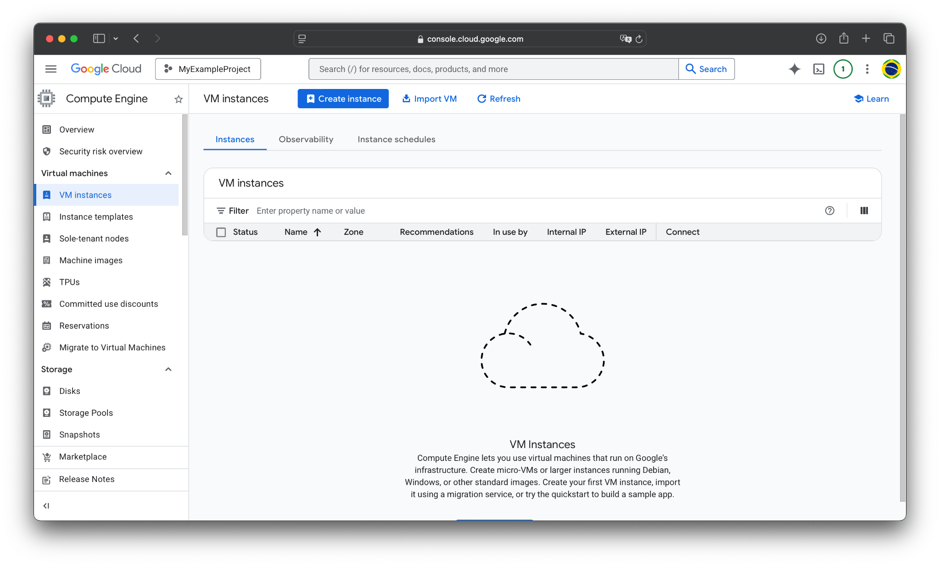
Click Create instance.

Slide 20
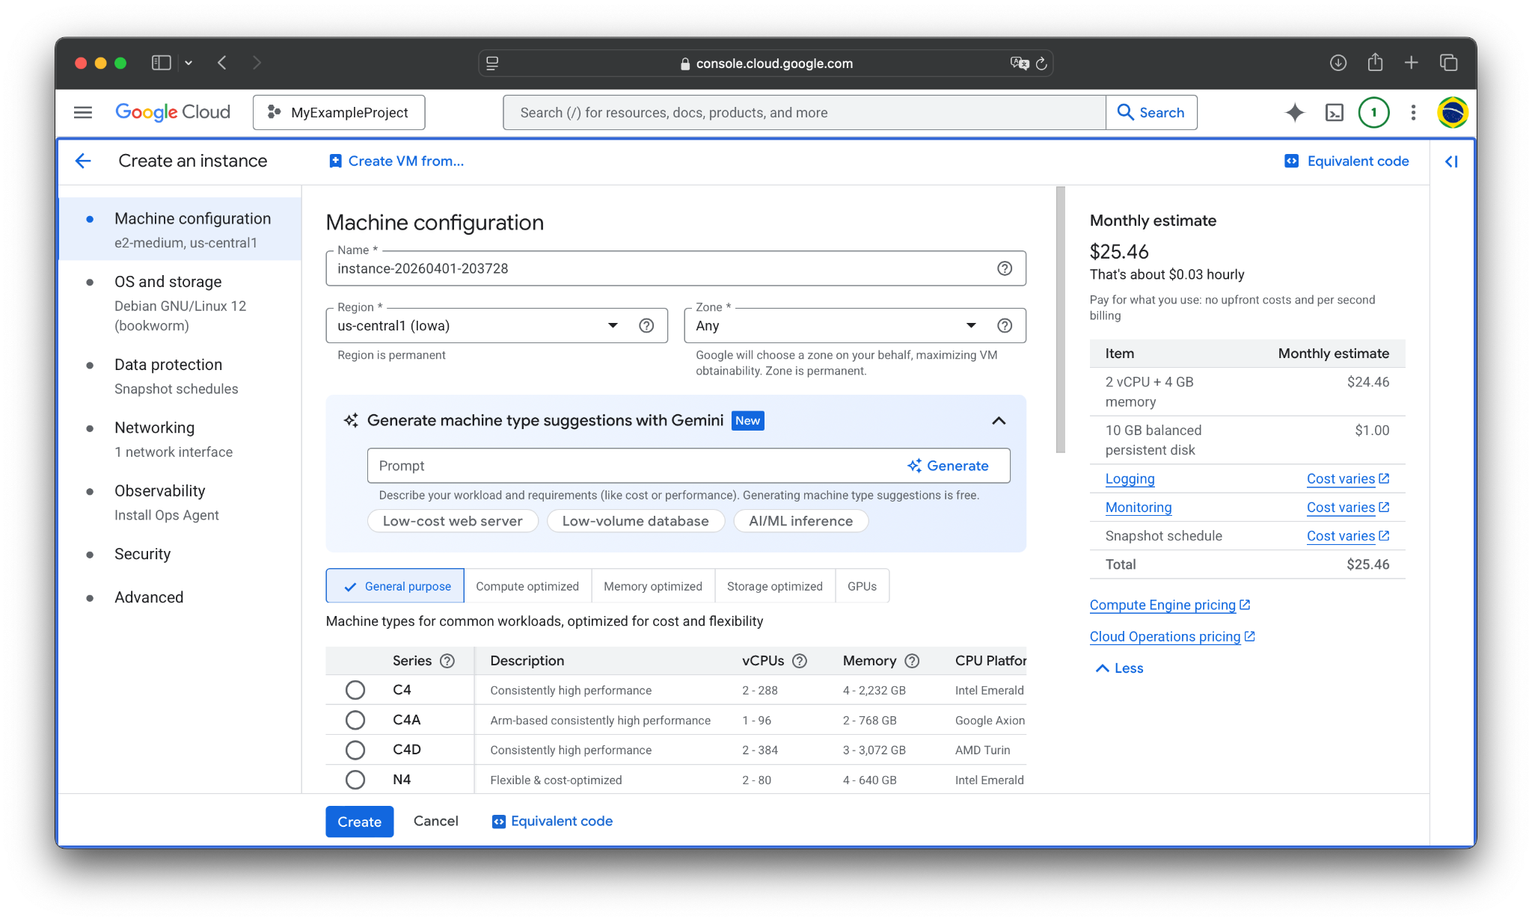
You will get this menu.

Slide 21
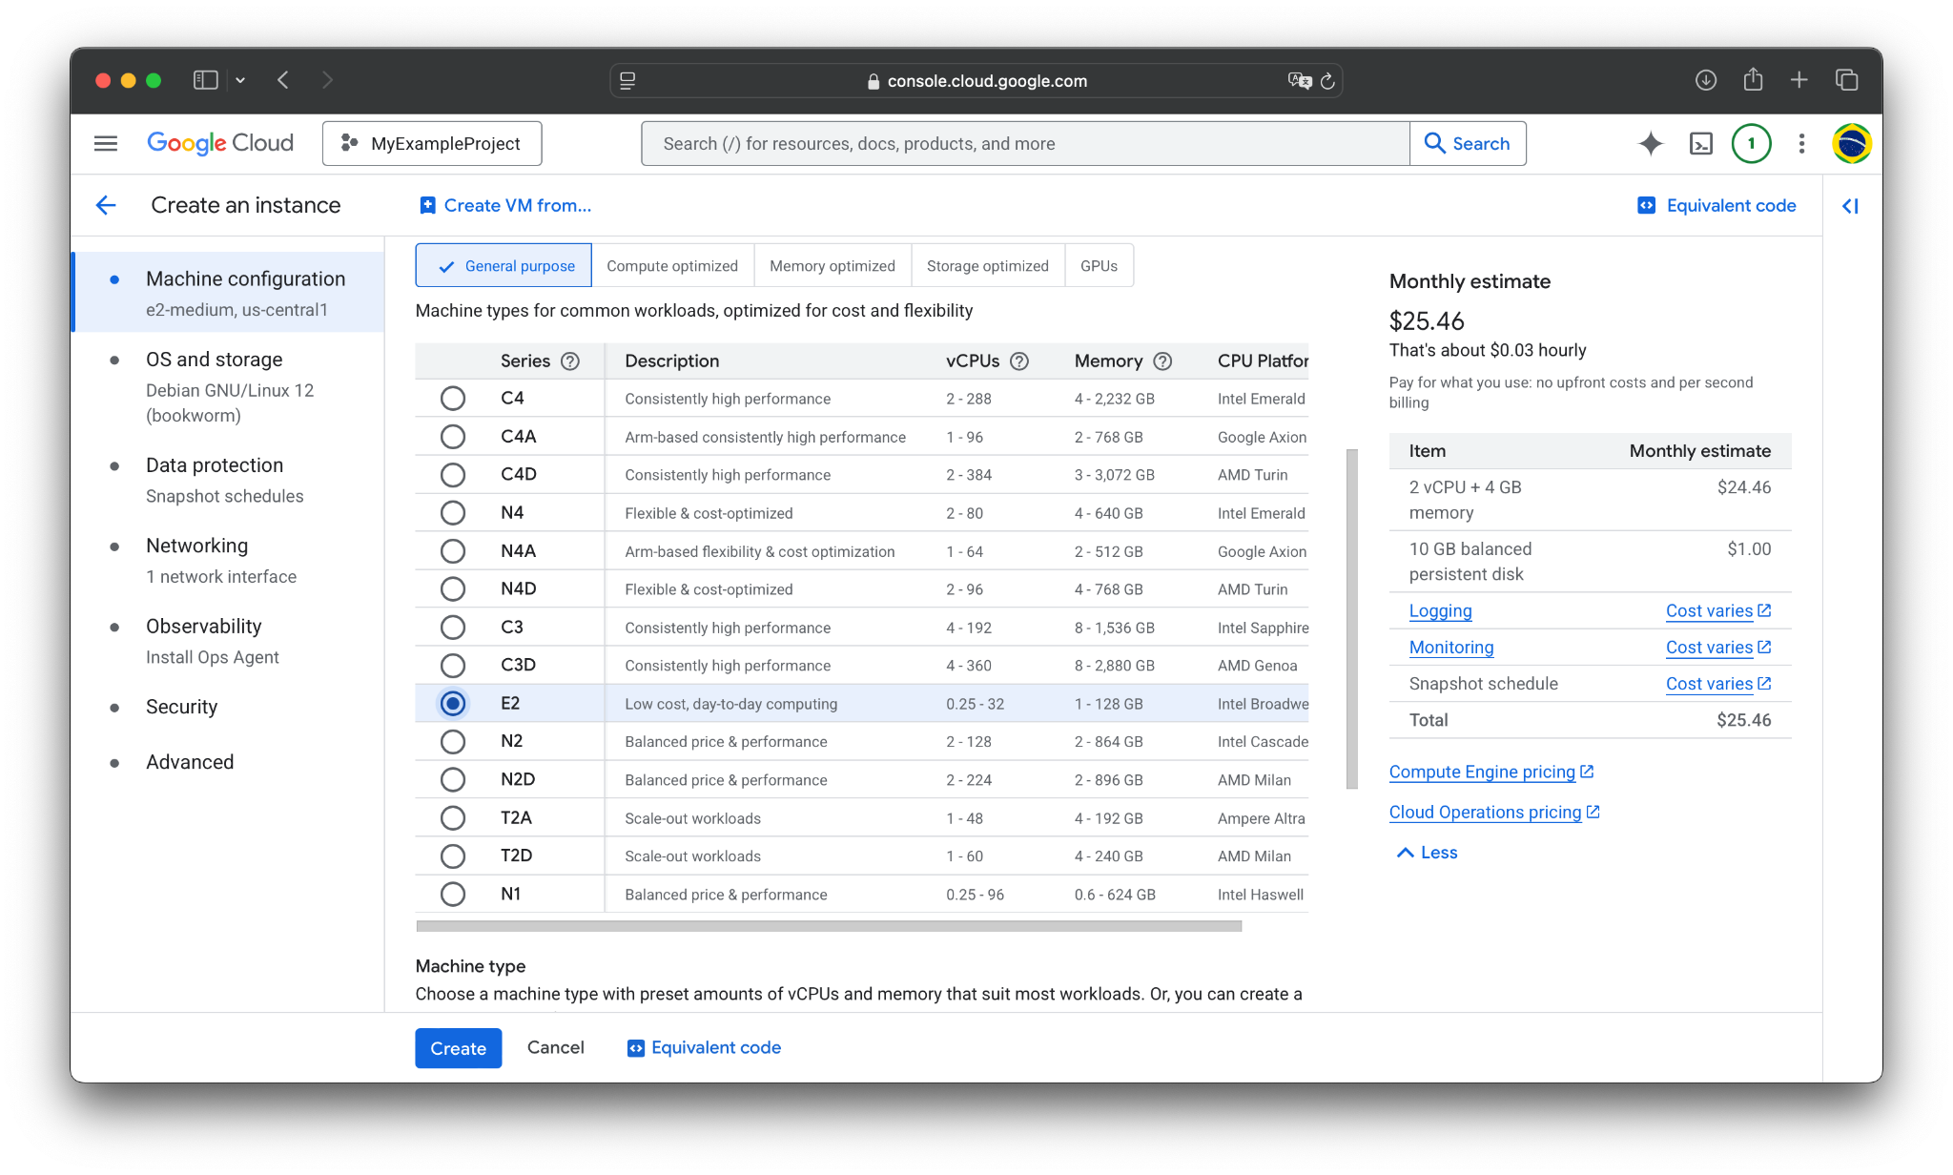
Scroll down to see all the series.
We want series E2.

Slide 22
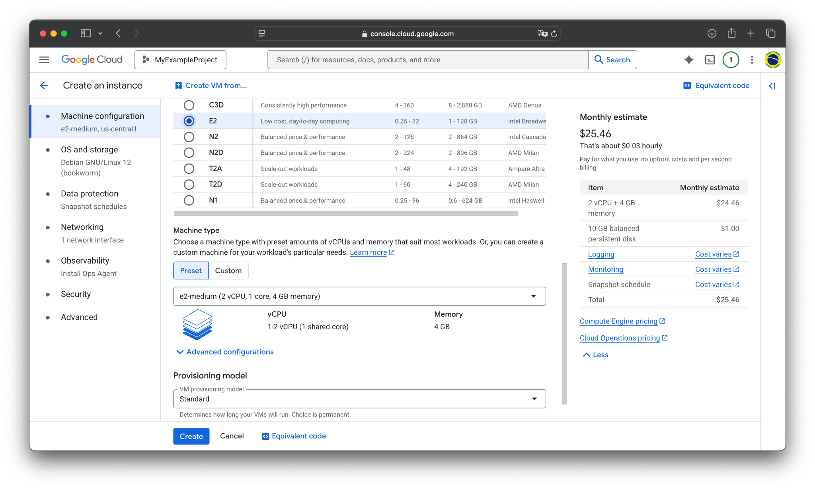
We want series E2.
Choose e2-medium

Slide 23
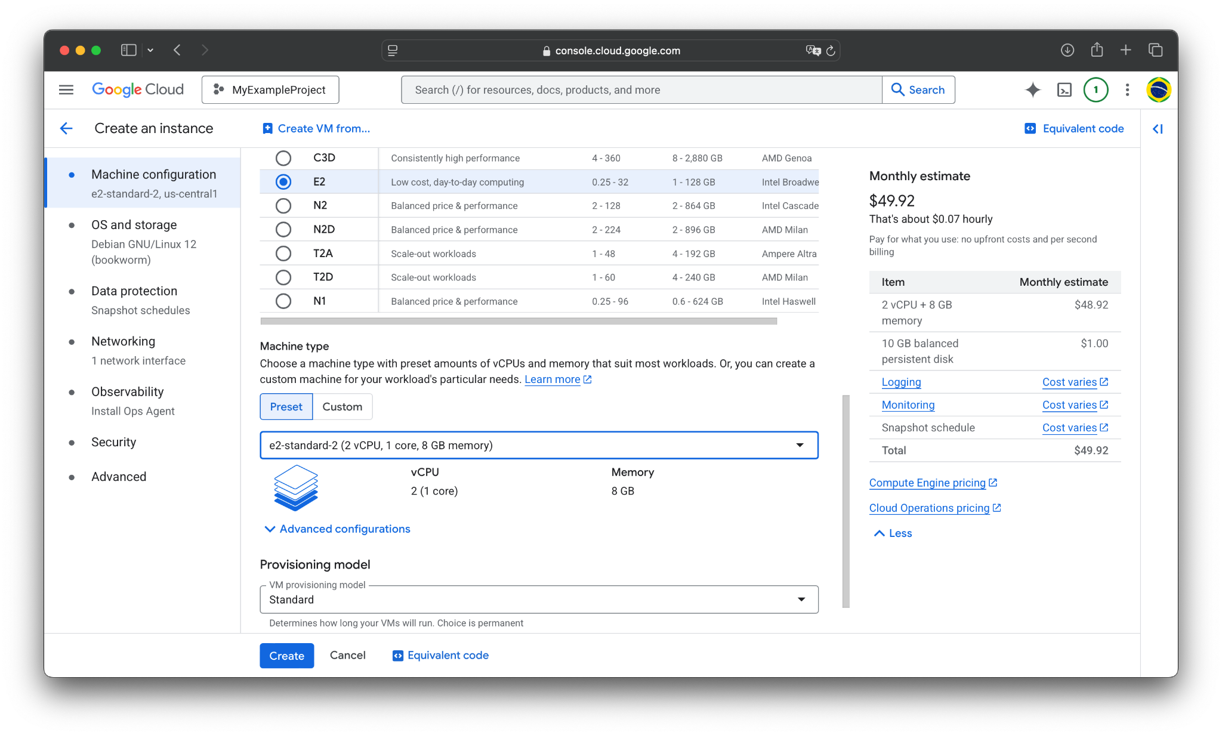
Click on OS and storage in the sidebar.

Slide 24
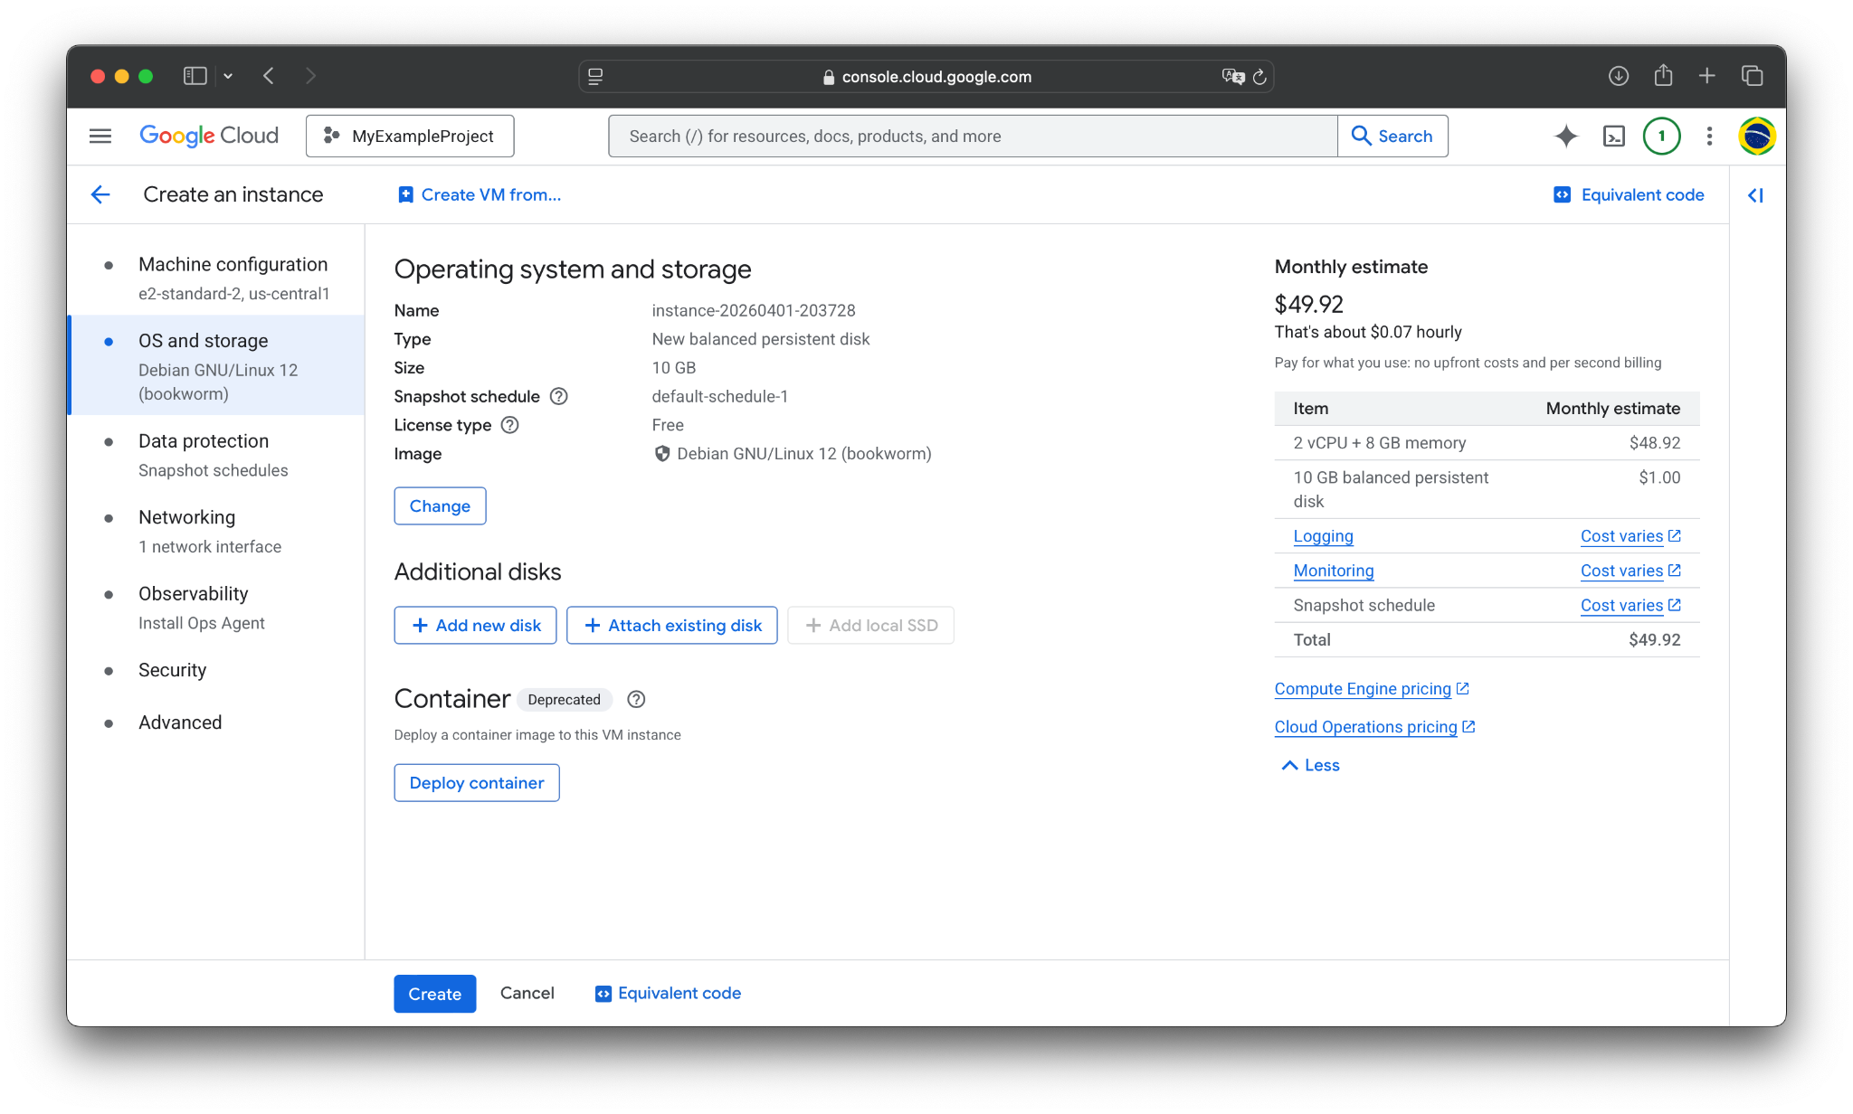
Click here to change the OS and boot disk type.

Slide 25
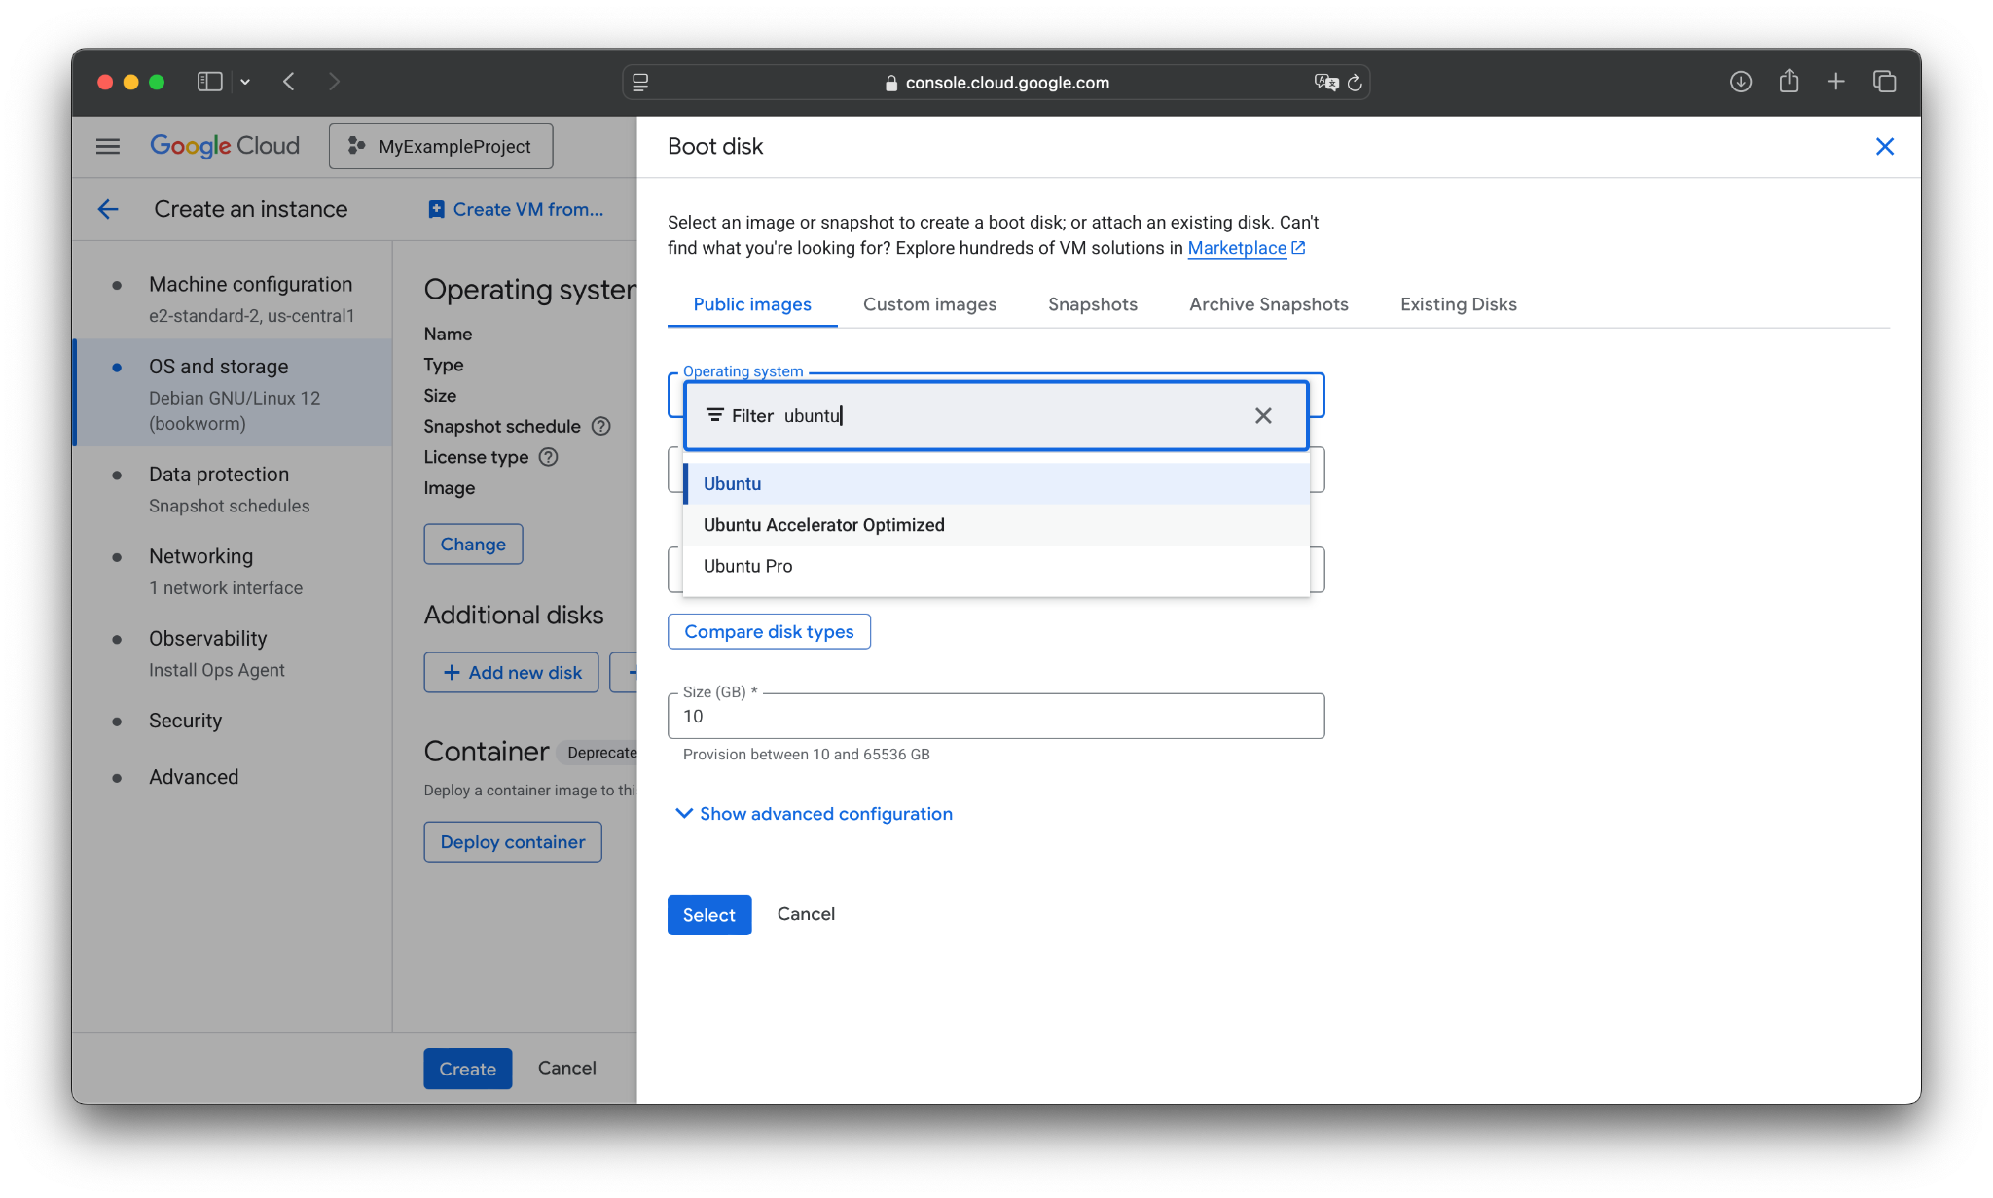
Let’s use Ubuntu for the demo. Scroll down or filter and select it.

Slide 26
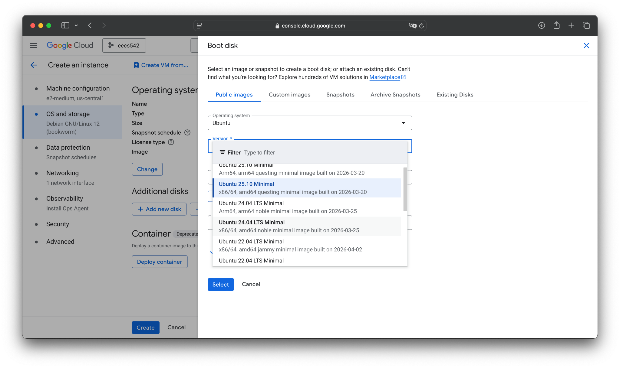
We will use the x86/64 Ubuntu 24.04 LTS Minimal.

Slide 27
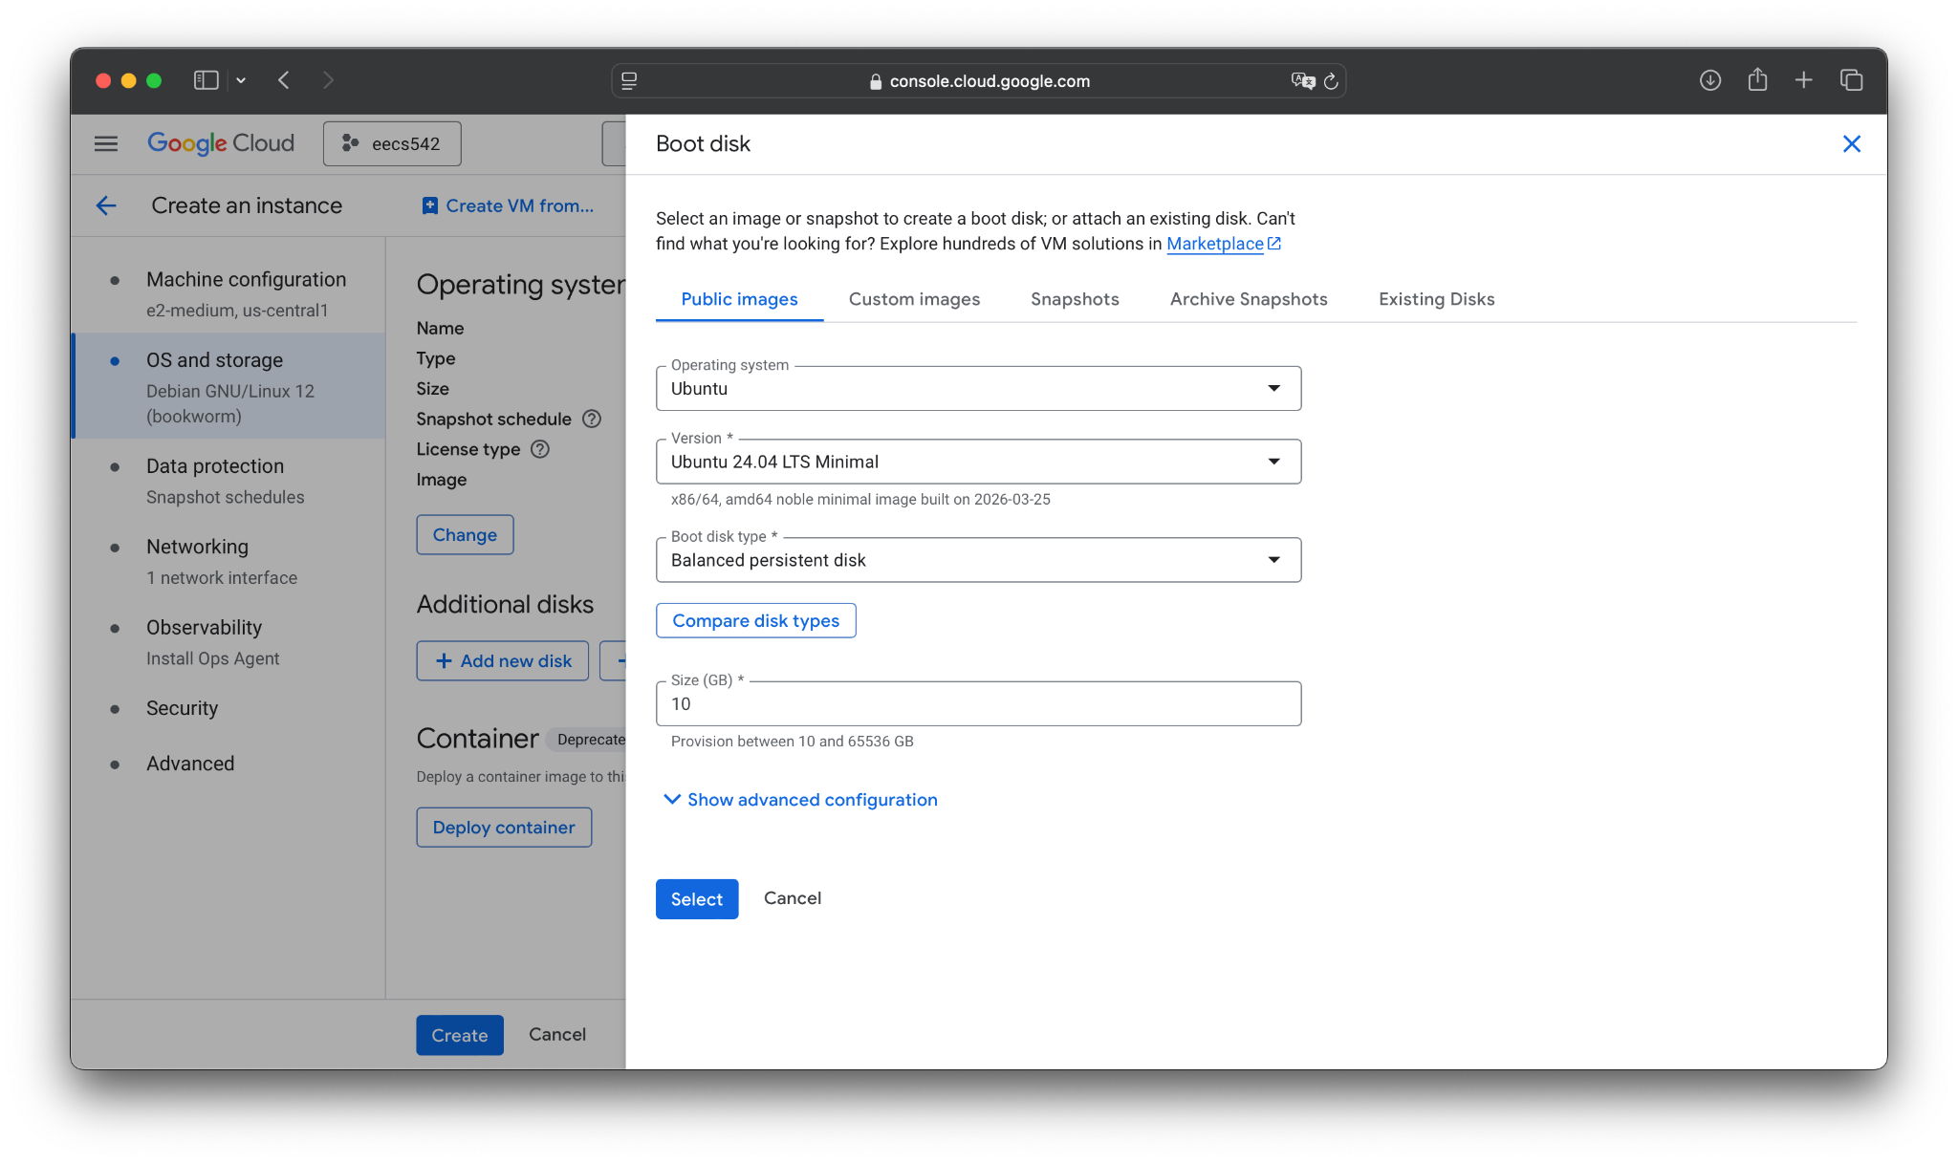

Slide 28
Now change the boot disk to 20 GB of Standard Persistent Disk.

Slide 29
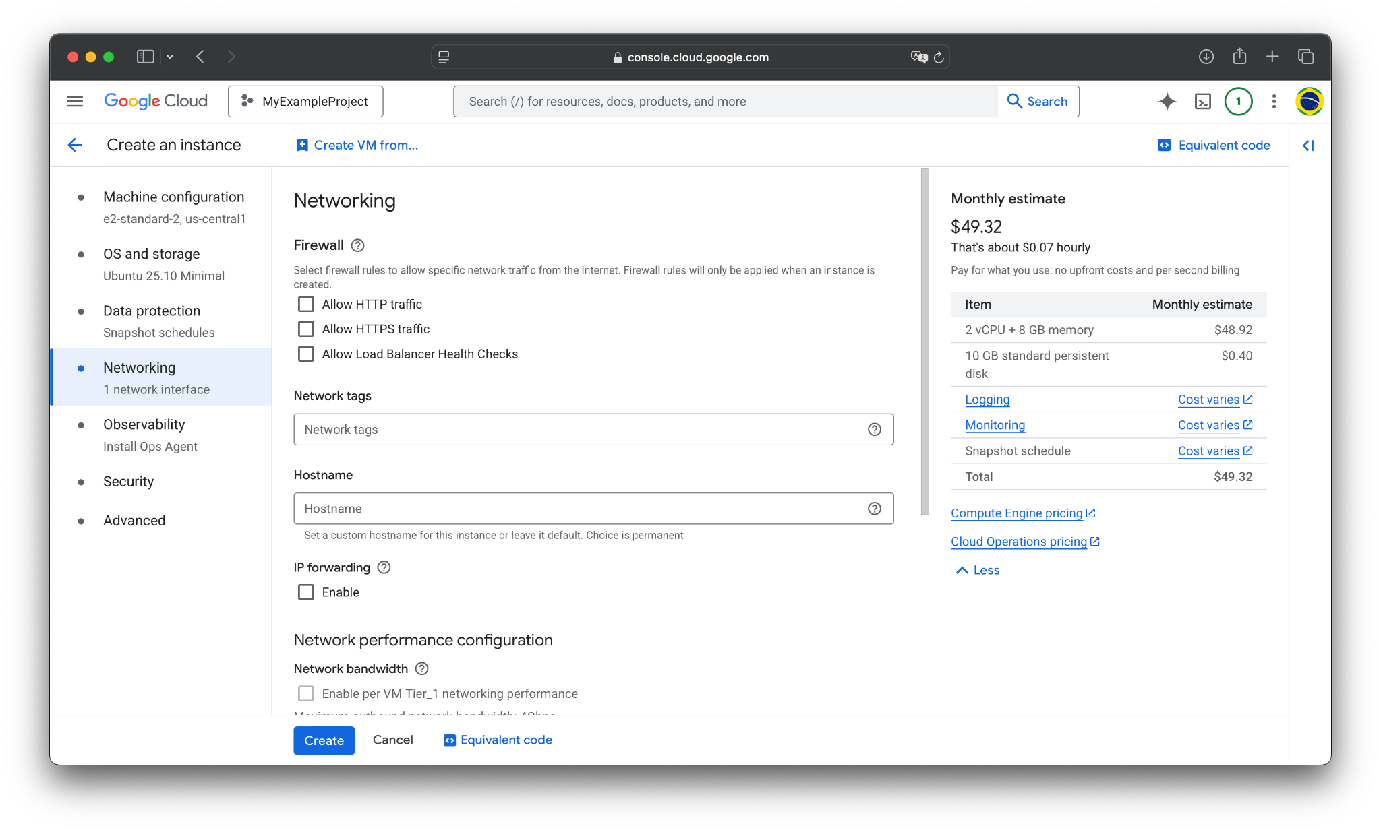

Now go to the Networking tab, and scroll down until you see Firewall settings.

Slide 30
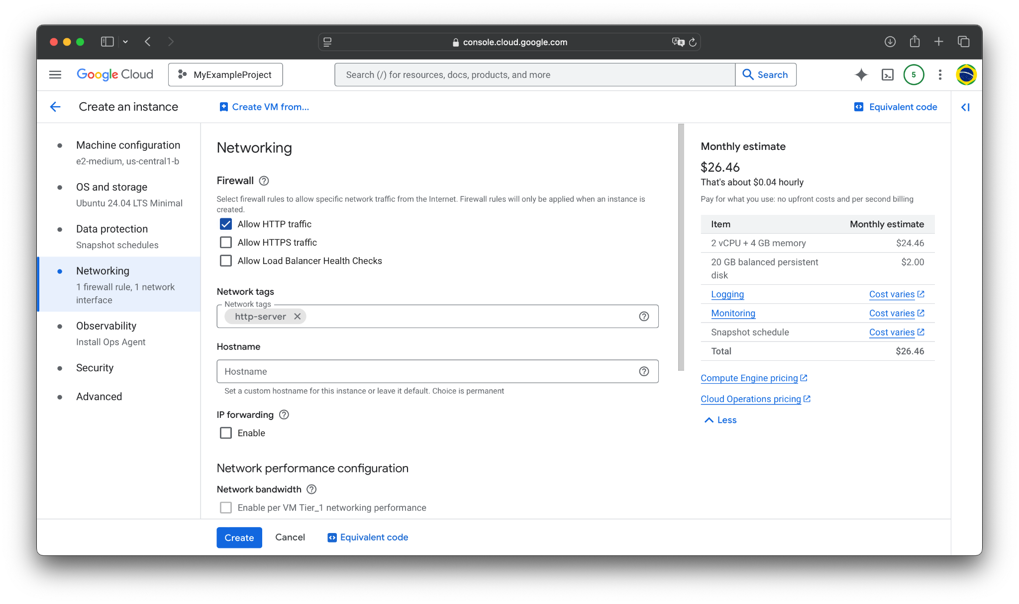
Check Allow HTTP traffic.

Slide 31
Now hit Create.

Slide 32
Agenda
Introduction
Project SSH Keys
Creating a VM Instance
Building & Running LinuxTinyServer
Configuring a systemd service

Slide 33
Setting Up the VM Environent
Let’s set up our VM environment just like we did for LinuxGetSsl.
You can:
SSH from the web console directly
Add a local SSH key to the instance like in the previous lab
Or, SSH using gcloud, which automatically handles the local keys

Slide 34
Setting Up the VM Environent
Let’s set up our VM environment just like we did for LinuxGetSsl.
You can:
SSH from the web console directly
Add a local SSH key to the instance like in the previous lab
Or, SSH using gcloud CLI, which automatically handles the local keys
Since we already set up a global SSH key for the project, we can just run:
ssh -i ~/.ssh/gcp_key <username>@<vm_external_ip>

Slide 35
Setting Up the VM Environent (review)
Now we set up the environment exactly as with LinuxGetSsl.
In particular, run these commands in the SSH terminal on the VM:
Then depending on if you want vim or nano:
sudo apt update && sudo apt upgrade -y
sudo apt install -y build-essential cmake git gdb
sudo apt install -y vim
or
sudo apt install -y nano

Slide 36
Getting Code onto GCP
Now, we just need to get our LinuxTinyServer code onto GCP.
Just like last lab, there are several ways to do this. Namely:
Setting up Github credentials on GCP (or vice versa)
Using scp or rsync with a local SSH key
Using gcloud

Slide 37
Getting Code onto GCP (scp)
For example, with this tutorial’s naming, I would run:
scp -r -i ~/.ssh/gcp_key \
~/local/path/to/my/code \
<username>@<vm_ip>:~/LinuxTinyServer

Slide 38
Getting HTML onto GCP
Since this is a web-server, we need some HTML to serve.
Luckily, we already have some from the HTMLParser assignment, such as the NYTimes.html file.
Let’s put them in a ~/html directory. On the remote VM, run:
mkdir ~/html

Slide 39
Getting HTML onto GCP
For every local HTML file example.html that you want to copy, run this locally:
Note the trailing slash in ~/html/
scp -i ~/.ssh/gcp_key \
~/local/path/to/my/code \
<username>@<vm_ip>:~/html/

Slide 40
Getting HTML onto GCP
For every local HTML file example.html that you want to copy, run this locally:
Note the trailing slash in ~/html/
You can also get new webpages with curl; e.g., on the remote VM you can do:
scp -i ~/.ssh/gcp_key \
~/local/path/to/my/code \
<username>@<vm_ip>:~/html/
curl -L -o ~/html/linux.html "https://en.wikipedia.org/wiki/Linux"

Slide 41
Building & Running LinuxTinyServer
Now, you can build and run LinuxTinyServer as you usually would.
For instance:
cd ~/LinuxTinyServer
g++ -pthread LinuxTinyServer.cpp -o LinuxTinyServer
sudo ./LinuxTinyServer 80 ~/html

Slide 42
Connecting to LinuxTinyServer
We can then connect to the LinuxTinyServer as usual, except we specify the external IP of the VM instance instead of localhost.
I.e., you can enter the following into your browser:
http://{vm_ip_address}/{file_name}.html

Slide 43
Connecting to LinuxTinyServer
We can then connect to the LinuxTinyServer as usual, except we specify the external IP of the VM instance instead of localhost.
I.e., you can enter the following into your browser:
Alternatively, fetch with curl (might have to use --http0.9 flag):
http://{vm_ip_address}/{file_name}.html
curl -v http://{vm_ip_address}/{file_name}.html

Slide 44

Here’s NYTimes.html on my demo server.
http://{ip_addr}/NYTimes.html

Slide 45
Agenda
Introduction
Project SSH Keys
Creating a VM Instance
Building & Running LinuxTinyServer
Configuring a systemd service

Slide 46
Reliably Run a Long-Running Service
We can now run our LinuxTinyServer and serve incoming requests.
However, merely running it from the terminal means it may die whenever our SSH session ends.
Using something like tmux can help, but it is not a permanent solution:
Has session overhead
Not an OS first-class citizen
No automatic restarts or reliability
The “real” solution here is to use a systemd service.

Slide 47
Configuring systemd
We can define a service via a .service file in the systemd directory.
This is an INI file (sort of like YAML) that defines the config for the service.
For instance, it can control:
Automatic restarts
Starting service on boot
User/Group permissions
Executable to run (and its argument)
Environment variables
Working directory (where the executable is run)

Slide 48
Making a New Service
We will create /etc/systemd/system/linuxtinyserver.service
You can find an example linuxtinyserver.service file on Canvas in Files, under Labs/Lab 11.
Download this file, and then edit it to replace all instances of <username> with the username you used to SSH into the VM.

Slide 49
Adding Service to systemd
Now, we just need to put this file into the /etc/systemd/system/ directory.
You can do this by copy/pasting with vim or nano, or by using scp / nano.
For instance, on a local terminal:
And then on the remote VM instance:
scp -i ~/.ssh/gcp_key \
~/local/path/to/linuxtinyserver.service \
<username>@<vm_ip>:~/LinuxTinyServer/
sudo cp ~/LinuxTinyServer/linuxtinyserver.service \
/etc/systemd/system/

Slide 50
Service Permissions
Make sure the service file has the proper ownership and permissions:
sudo chown root:root /etc/systemd/system/linuxtinyserver.service
sudo chmod 644 /etc/systemd/system/linuxtinyserver.service

Slide 51
[Unit]
Description=Linux Tiny Server C++ Binary
After=network-online.target # Ensures the network is up before starting the service
Wants=network-online.target
[Service]
Type=simple
User=<username> # Run service as your user rather than root (recommended for security)
Group=<username>
Restart=always # Automatically restart the service if it crashes
RestartSec=3 # Wait 3 seconds before restarting
StandardOutput=journal
StandardError=journal
TimeoutStopSec=30
# The absolute path to your executable
ExecStart=/home/<username>/LinuxTinyServer/LinuxTinyServer 80 /home/<username>/html
# The directory from which the binary is run
WorkingDirectory=/home/<username>/LinuxTinyServer
[Install]
WantedBy=multi-user.target # Starts the service in standard multi-user boot mode
Here’s an overview of the file.
Note: this is condensed to fit on the slide and not technically valid; comments in INI have to be on their own lines.

Slide 52
Explaining the Service File
As you can see, there are a lot of options on this service file, and even more you can set.
We will briefly go over each of the specified attributes in the example file.
There are a lot of other fields and options you can set. I’d recommend reading more documentation on the later.
E.g.,
https://docs.redhat.com/en/documentation/red_hat_enterprise_linux/9/html/using_systemd_unit_files_to_customize_and_optimize_your_system/assembly_working-with-systemd-unit-files_working-with-systemd

Slide 53
[Unit]
Description=Linux Tiny Server C++ Binary
After=network-online.target # Ensures the network is up before starting the service
Wants=network-online.target
[Service]
Type=simple
User=<username> # Run service as your user rather than root (recommended for security)
Group=<username>
Restart=always # Automatically restart the service if it crashes
RestartSec=3 # Wait 3 seconds before restarting
StandardOutput=journal
StandardError=journal
TimeoutStopSec=30
# The absolute path to your executable
ExecStart=/home/<username>/LinuxTinyServer/LinuxTinyServer 80 /home/<username>/html
# The directory from which the binary is run
WorkingDirectory=/home/<username>/LinuxTinyServer
[Install]
WantedBy=multi-user.target # Starts the service in standard multi-user boot mode
The Description is a simple plaintext description of the service.

Slide 54
[Unit]
Description=Linux Tiny Server C++ Binary
After=network-online.target # Ensures the network is up before starting the service
Wants=network-online.target
[Service]
Type=simple
User=<username> # Run service as your user rather than root (recommended for security)
Group=<username>
Restart=always # Automatically restart the service if it crashes
RestartSec=3 # Wait 3 seconds before restarting
StandardOutput=journal
StandardError=journal
TimeoutStopSec=30
# The absolute path to your executable
ExecStart=/home/<username>/LinuxTinyServer/LinuxTinyServer 80 /home/<username>/html
# The directory from which the binary is run
WorkingDirectory=/home/<username>/LinuxTinyServer
[Install]
WantedBy=multi-user.target # Starts the service in standard multi-user boot mode
The After and Wants line here indicate that the service should wait for network-online.target
I.e., it waits for the network to be online before starting the service

Slide 55
[Unit]
Description=Linux Tiny Server C++ Binary
After=network-online.target # Ensures the network is up before starting the service
Wants=network-online.target
[Service]
Type=simple
User=<username> # Run service as your user rather than root (recommended for security)
Group=<username>
Restart=always # Automatically restart the service if it crashes
RestartSec=3 # Wait 3 seconds before restarting
StandardOutput=journal
StandardError=journal
TimeoutStopSec=30
# The absolute path to your executable
ExecStart=/home/<username>/LinuxTinyServer/LinuxTinyServer 80 /home/<username>/html
# The directory from which the binary is run
WorkingDirectory=/home/<username>/LinuxTinyServer
[Install]
WantedBy=multi-user.target # Starts the service in standard multi-user boot mode
The Type here indicates how the service acts: is it a daemon, does it fork, etc.
simple is the default and means a simple process that does not need to handle forking or acting as a daemon.

Slide 56
[Unit]
Description=Linux Tiny Server C++ Binary
After=network-online.target # Ensures the network is up before starting the service
Wants=network-online.target
[Service]
Type=simple
User=<username> # Run service as your user rather than root (recommended for security)
Group=<username>
Restart=always # Automatically restart the service if it crashes
RestartSec=3 # Wait 3 seconds before restarting
StandardOutput=journal
StandardError=journal
TimeoutStopSec=30
# The absolute path to your executable
ExecStart=/home/<username>/LinuxTinyServer/LinuxTinyServer 80 /home/<username>/html
# The directory from which the binary is run
WorkingDirectory=/home/<username>/LinuxTinyServer
[Install]
WantedBy=multi-user.target # Starts the service in standard multi-user boot mode
User and Group specify the user/group permissions the service will have.
For brevity, we will just set them to your username on the VM.
For a real service, it would be better to set a custom User and Group.

Slide 57
[Unit]
Description=Linux Tiny Server C++ Binary
After=network-online.target # Ensures the network is up before starting the service
Wants=network-online.target
[Service]
Type=simple
User=<username> # Run service as your user rather than root (recommended for security)
Group=<username>
Restart=always # Automatically restart the service if it crashes
RestartSec=3 # Wait 3 seconds before restarting
StandardOutput=journal
StandardError=journal
TimeoutStopSec=30
# The absolute path to your executable
ExecStart=/home/<username>/LinuxTinyServer/LinuxTinyServer 80 /home/<username>/html
# The directory from which the binary is run
WorkingDirectory=/home/<username>/LinuxTinyServer
[Install]
WantedBy=multi-user.target # Starts the service in standard multi-user boot mode
Restart controls how the service restarts.
always means it always restarts, but there is also an on-failure option, which only restarts for non-zero exit statuses
RestartSec is how many second between restarts.

Slide 58
[Unit]
Description=Linux Tiny Server C++ Binary
After=network-online.target # Ensures the network is up before starting the service
Wants=network-online.target
[Service]
Type=simple
User=<username> # Run service as your user rather than root (recommended for security)
Group=<username>
Restart=always # Automatically restart the service if it crashes
RestartSec=3 # Wait 3 seconds before restarting
StandardOutput=journal
StandardError=journal
TimeoutStopSec=30
# The absolute path to your executable
ExecStart=/home/<username>/LinuxTinyServer/LinuxTinyServer 80 /home/<username>/html
# The directory from which the binary is run
WorkingDirectory=/home/<username>/LinuxTinyServer
[Install]
WantedBy=multi-user.target # Starts the service in standard multi-user boot mode
This controls where stdout and stderr get sent.
The default is the systemd journal. I set it here to be explicit.

Slide 59
[Unit]
Description=Linux Tiny Server C++ Binary
After=network-online.target # Ensures the network is up before starting the service
Wants=network-online.target
[Service]
Type=simple
User=<username> # Run service as your user rather than root (recommended for security)
Group=<username>
Restart=always # Automatically restart the service if it crashes
RestartSec=3 # Wait 3 seconds before restarting
StandardOutput=journal
StandardError=journal
TimeoutStopSec=30
# The absolute path to your executable
ExecStart=/home/<username>/LinuxTinyServer/LinuxTinyServer 80 /home/<username>/html
# The directory from which the binary is run
WorkingDirectory=/home/<username>/LinuxTinyServer
[Install]
WantedBy=multi-user.target # Starts the service in standard multi-user boot mode
This is the time to stop the service.

Slide 60
[Unit]
Description=Linux Tiny Server C++ Binary
After=network-online.target # Ensures the network is up before starting the service
Wants=network-online.target
[Service]
Type=simple
User=<username> # Run service as your user rather than root (recommended for security)
Group=<username>
Restart=always # Automatically restart the service if it crashes
RestartSec=3 # Wait 3 seconds before restarting
StandardOutput=journal
StandardError=journal
TimeoutStopSec=30
# The absolute path to your executable
ExecStart=/home/<username>/LinuxTinyServer/LinuxTinyServer 80 /home/<username>/html
# The directory from which the binary is run
WorkingDirectory=/home/<username>/LinuxTinyServer
[Install]
WantedBy=multi-user.target # Starts the service in standard multi-user boot mode
ExecStart is the absolute path to the executable, along with any arguments for the program.

Slide 61
[Unit]
Description=Linux Tiny Server C++ Binary
After=network-online.target # Ensures the network is up before starting the service
Wants=network-online.target
[Service]
Type=simple
User=<username> # Run service as your user rather than root (recommended for security)
Group=<username>
Restart=always # Automatically restart the service if it crashes
RestartSec=3 # Wait 3 seconds before restarting
StandardOutput=journal
StandardError=journal
TimeoutStopSec=30
# The absolute path to your executable
ExecStart=/home/<username>/LinuxTinyServer/LinuxTinyServer 80 /home/<username>/html
# The directory from which the binary is run
WorkingDirectory=/home/<username>/LinuxTinyServer
[Install]
WantedBy=multi-user.target # Starts the service in standard multi-user boot mode
WorkingDirectory is the directory from which the executable will be run.

Slide 62
[Unit]
Description=Linux Tiny Server C++ Binary
After=network-online.target # Ensures the network is up before starting the service
Wants=network-online.target
[Service]
Type=simple
User=<username> # Run service as your user rather than root (recommended for security)
Group=<username>
Restart=always # Automatically restart the service if it crashes
RestartSec=3 # Wait 3 seconds before restarting
StandardOutput=journal
StandardError=journal
TimeoutStopSec=30
# The absolute path to your executable
ExecStart=/home/<username>/LinuxTinyServer/LinuxTinyServer 80 /home/<username>/html
# The directory from which the binary is run
WorkingDirectory=/home/<username>/LinuxTinyServer
[Install]
WantedBy=multi-user.target # Starts the service in standard multi-user boot mode
What this line does is make the service start automatically during bootup.
Specifically, during the multi-user (non-graphical, text mode) state.

Slide 63
Activating the Service
First, ensure the binary is executable:
Since port 80 is protected, we need to give LinuxTinyServer permission to use it.
You can do that with this command, replacing USERNAME with your username:
You can check the permissions with:
chmod +x ~/LinuxTinyServer/LinuxTinyServer
sudo setcap 'cap_net_bind_service=+ep' \
/home/USERNAME/LinuxTinyServer/LinuxTinyServer
getcap /home/USERNAME/LinuxTinyServer/LinuxTinyServer

Slide 64
Load and Start the Service
To run the service, do the following commands on the VM:
sudo systemctl daemon-reload
sudo systemctl enable linuxtinyserver
sudo systemctl start linuxtinyserver
sudo systemctl status linuxtinyserver

Slide 65
christopherdavis@demo-server:~$ sudo systemctl status linuxtinyserver
● linuxtinyserver.service - Linux Tiny Server C++ Binary
Loaded: loaded (/etc/systemd/system/linuxtinyserver.service; enabled; preset: enabled)
Active: active (running) since Fri 2026-04-10 16:01:36 UTC; 13s ago
Main PID: 7795 (LinuxTinyServer)
Tasks: 1 (limit: 4598)
Memory: 292.0K (peak: 460.0K)
CPU: 4ms
CGroup: /system.slice/linuxtinyserver.service
└─7795 /home/christopherdavis/LinuxTinyServer/LinuxTinyServer 80 /home/christopherdavis/html
Apr 10 16:01:36 demo-server systemd[1]: linuxtinyserver.service: Scheduled restart job, restart counter is at 96.
Apr 10 16:01:36 demo-server systemd[1]: Started linuxtinyserver.service - Linux Tiny Server C++ Binary.

Slide 66
Summary
Your service should be active!
It now runs independently of SSH sessions, and will automatically restart if the process dies or the VM reboots.
To stop your service (and prevent it from restarting on boot), run this:
To re-enable it, run the four commands on the previous step.
sudo systemctl disable --now linuxtinyserver

Slide 67
Summary
Remember to Suspend or Stop your VM!
In either case—since we created a systemd service—our web-server will reboot.

Slide 68
Next Steps
We will also release a guide on creating custom images, instance templates, and CI/CD with GitHub!

